Slide 1

ToMCAT-Offline-Viz
Caleb Jones Shibu, Harshita Narnoli, Rupal Jain

Slide 2
Background & Setup
Introduction & Research Question
Related Works
Research Plan
Results & Demo
References
Structure of Presentation

Slide 3
Background & Setup
05-01-2023

Slide 4
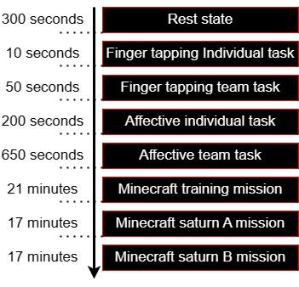
ToMCAT
ToMCAT, which stands for Theory of Mind-based Cognitive Architecture for Team, is a joint initiative between Computer Science and Social Science. Its main objective is to design an artificially intelligent (AI) teammates that will address some of the capabilities that they must have, including inferring the internal states of other agents solving problems collaboratively with them, and communicating with them in a socially-aware manner.
At the moment, there is a process of collecting data that requires an individual to participate in a variety of activities, some of which involve individual tasks while others are team-based.
ToMCAT is funded by DARPA (Defense Advanced Research Projects Agency).
ToMCAT Offline Viz | THE UNIVERSITY OF ARIZONA

Slide 5
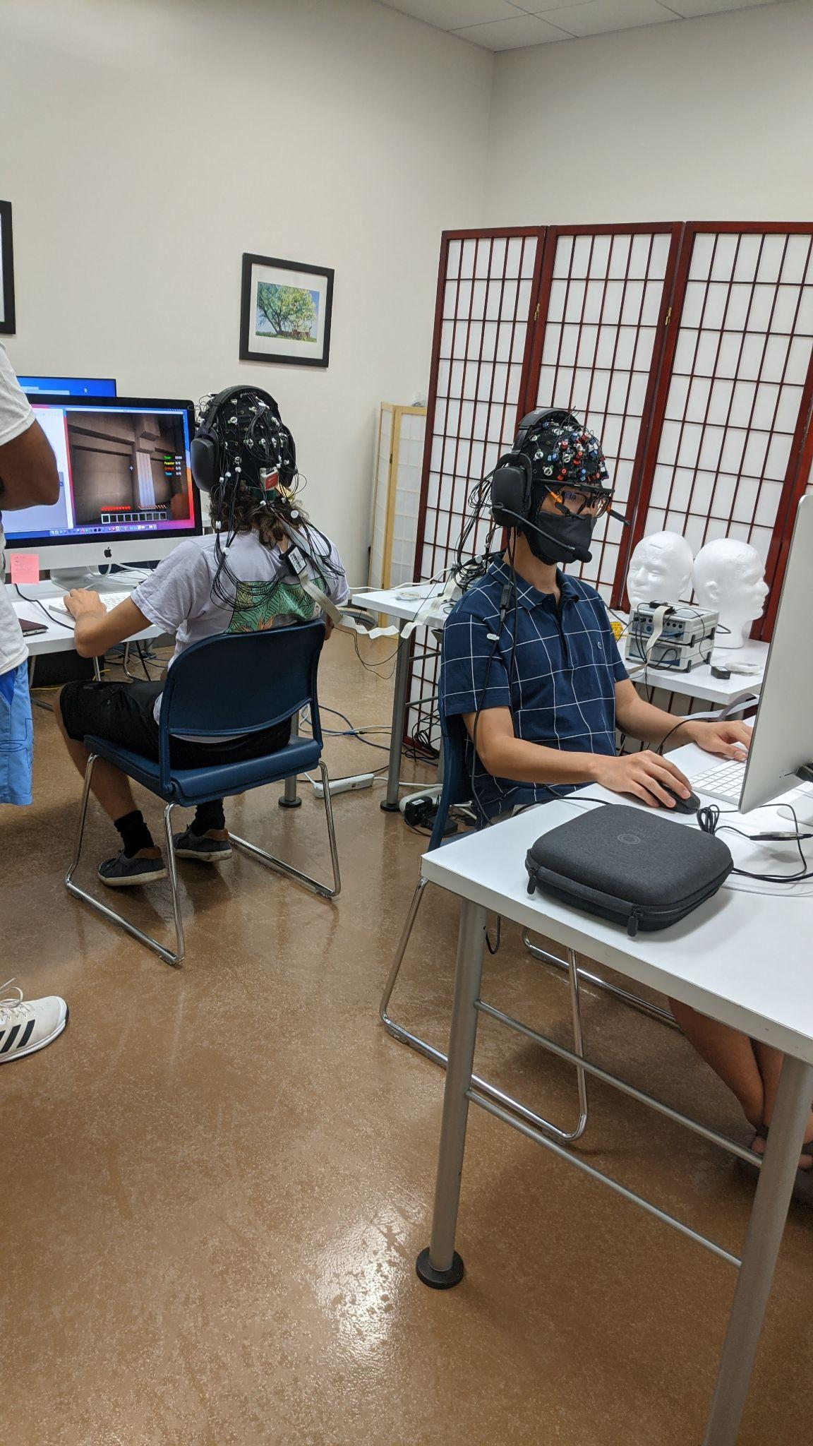
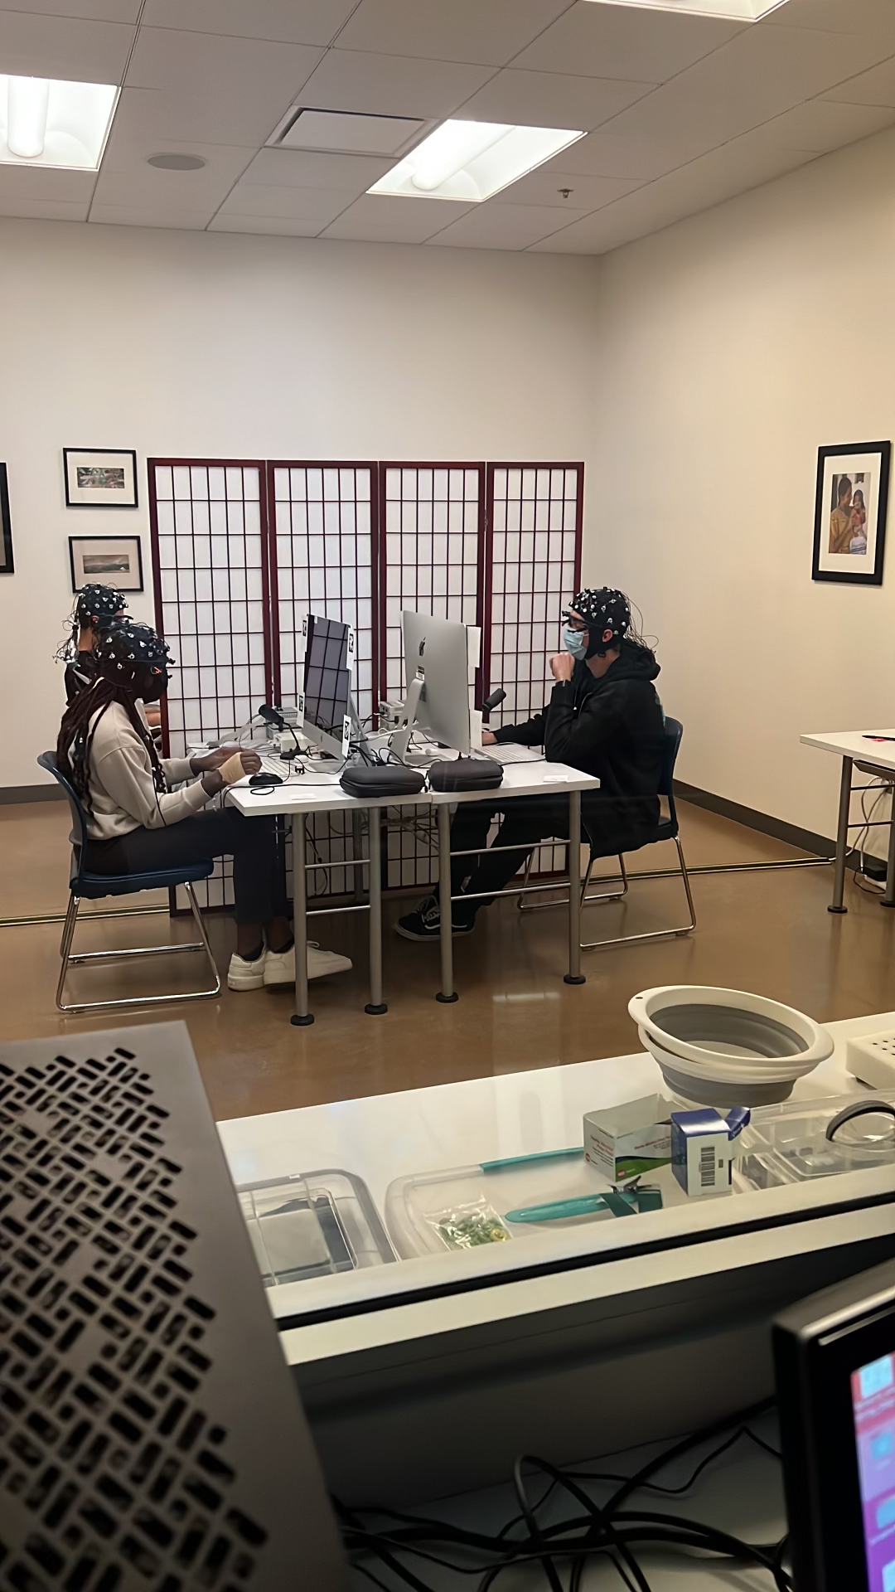
Experiment Room
View from Control Room
ToMCAT Offline Viz | THE UNIVERSITY OF ARIZONA

Slide 6
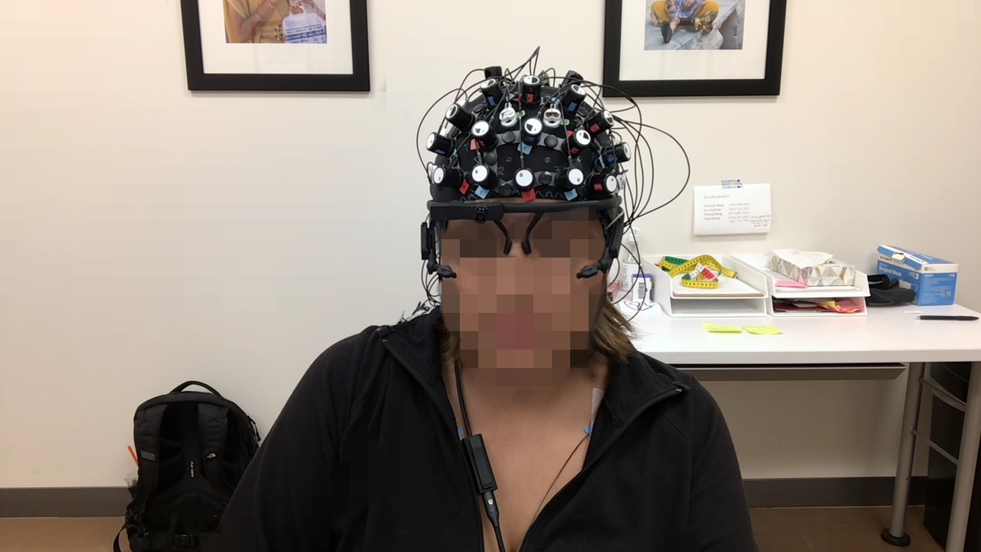
fNIRS (Functional Near-Infrared Spectroscopy) Optodes
EEG (Electroencephalogram) Electrodes
Eye tracker
EKG:Electrocardiogram
ToMCAT Offline Viz | THE UNIVERSITY OF ARIZONA
GSR (Galvanic Skin Response): On right hand
fNIRS records BOLD (Blood Oxygen Level Dependent) signals

Slide 7
Introduction & Research Question
05-01-2023

Slide 8
How will our tool help?
The ToMCAT offline visualization tool is a joint venture aimed at creating a comprehensive multimodal tool that integrates functional near-infrared spectroscopy (fNIRS), eye tracking, and electroencephalography (EEG) data.
This tool can offer a complete analysis of cognitive and perceptual functions such as attention, working memory, and emotion.
This tool is expected to simplify the work for social scientists.
ToMCAT Offline Viz | THE UNIVERSITY OF ARIZONA

Slide 9
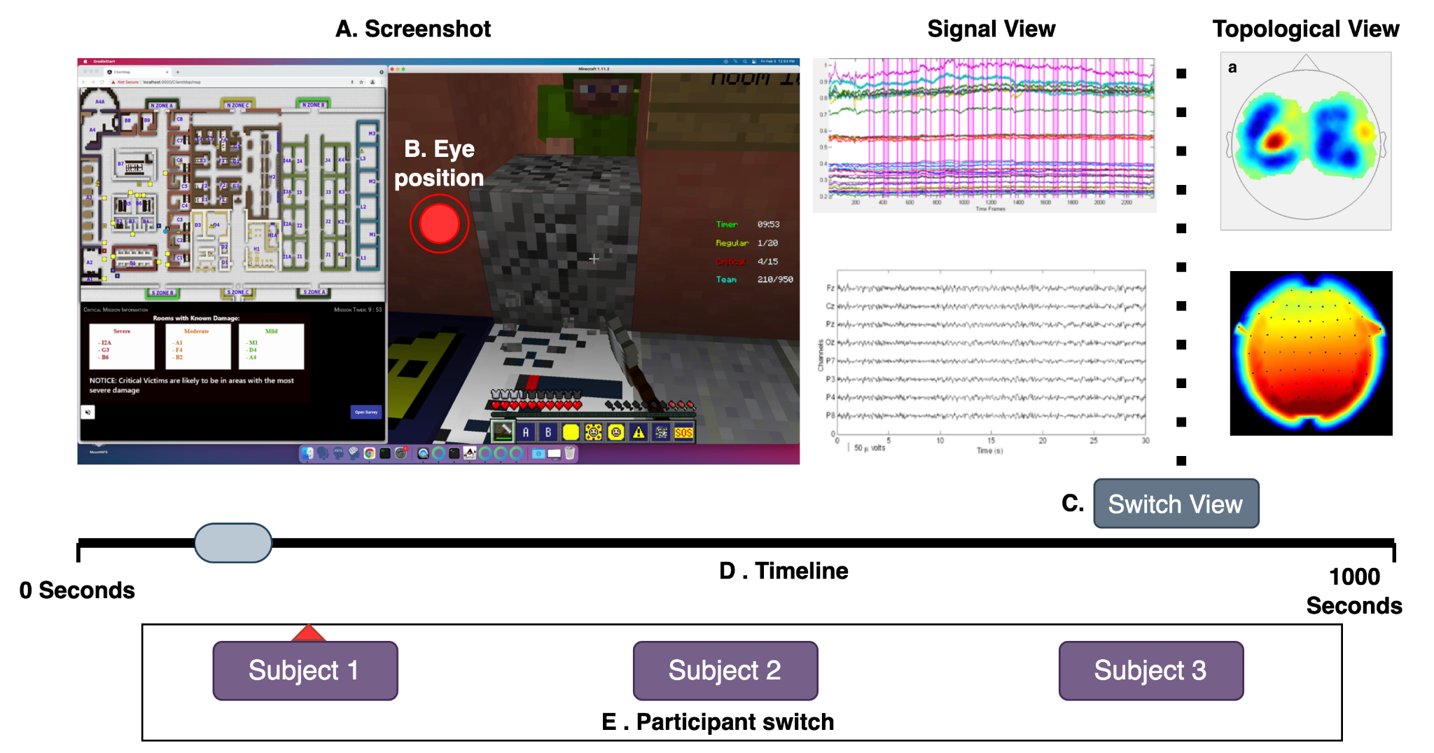
Design we proposed
ToMCAT Offline Viz | THE UNIVERSITY OF ARIZONA

Slide 10
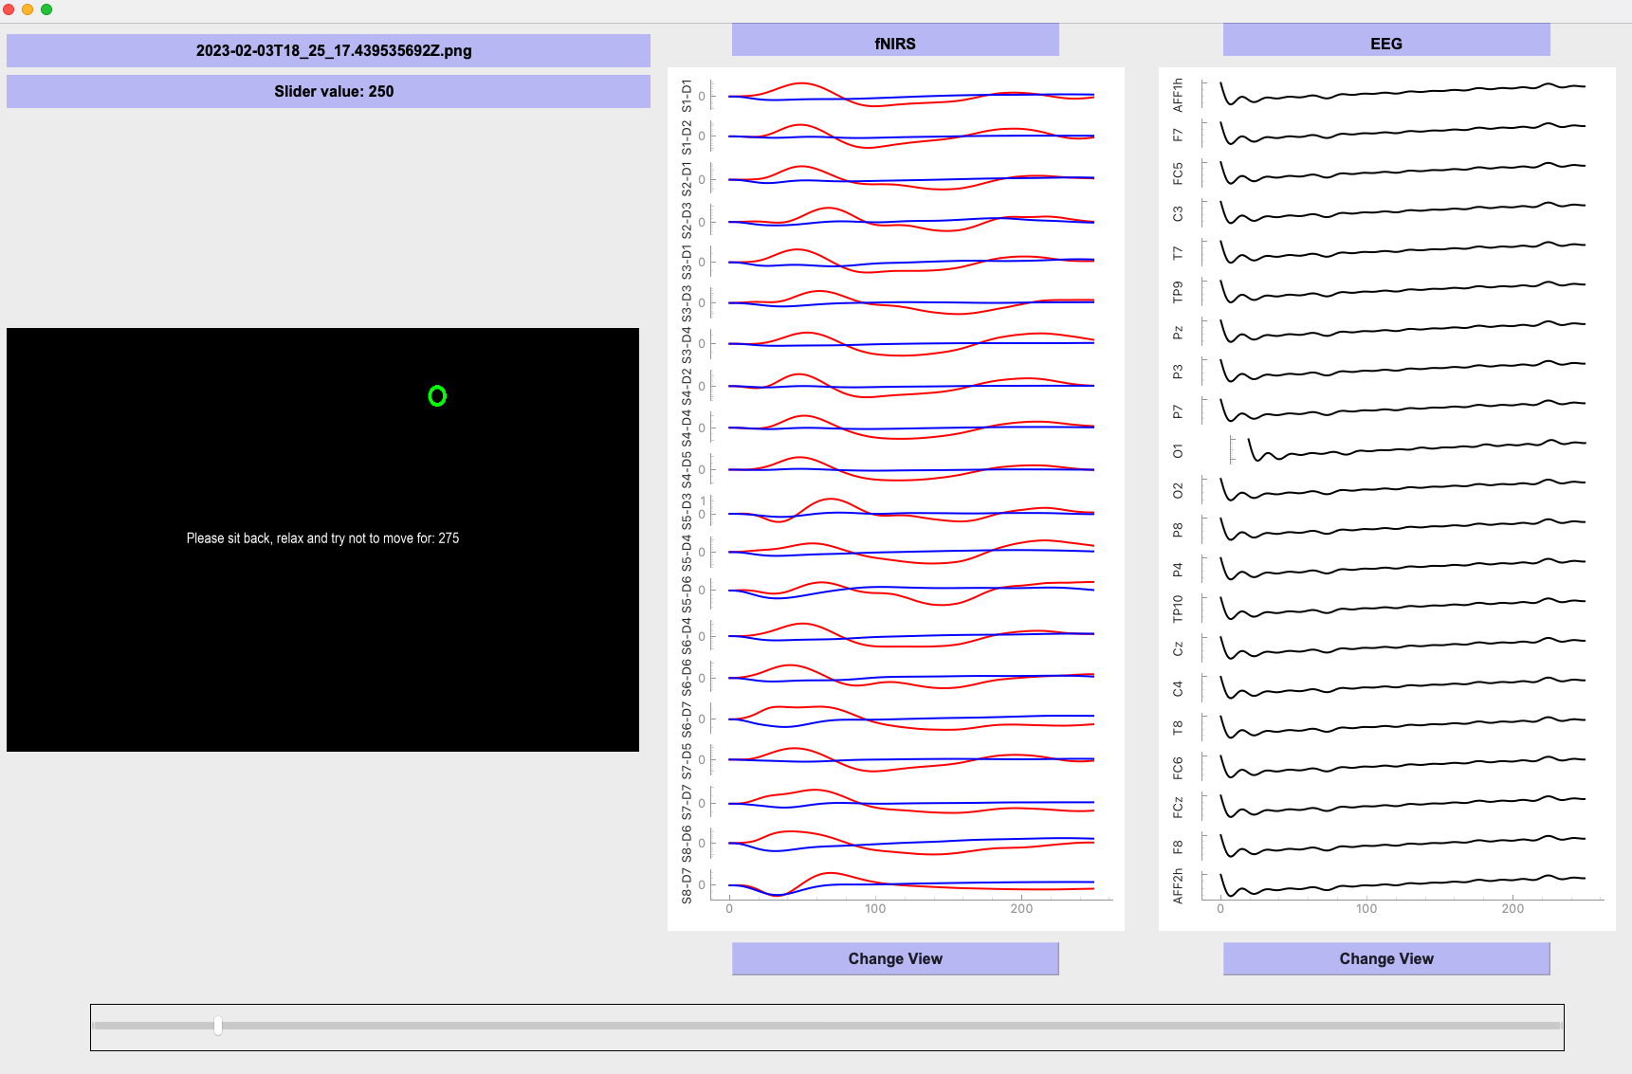
This is what we achieved.
ToMCAT Offline Viz | THE UNIVERSITY OF ARIZONA

Slide 11
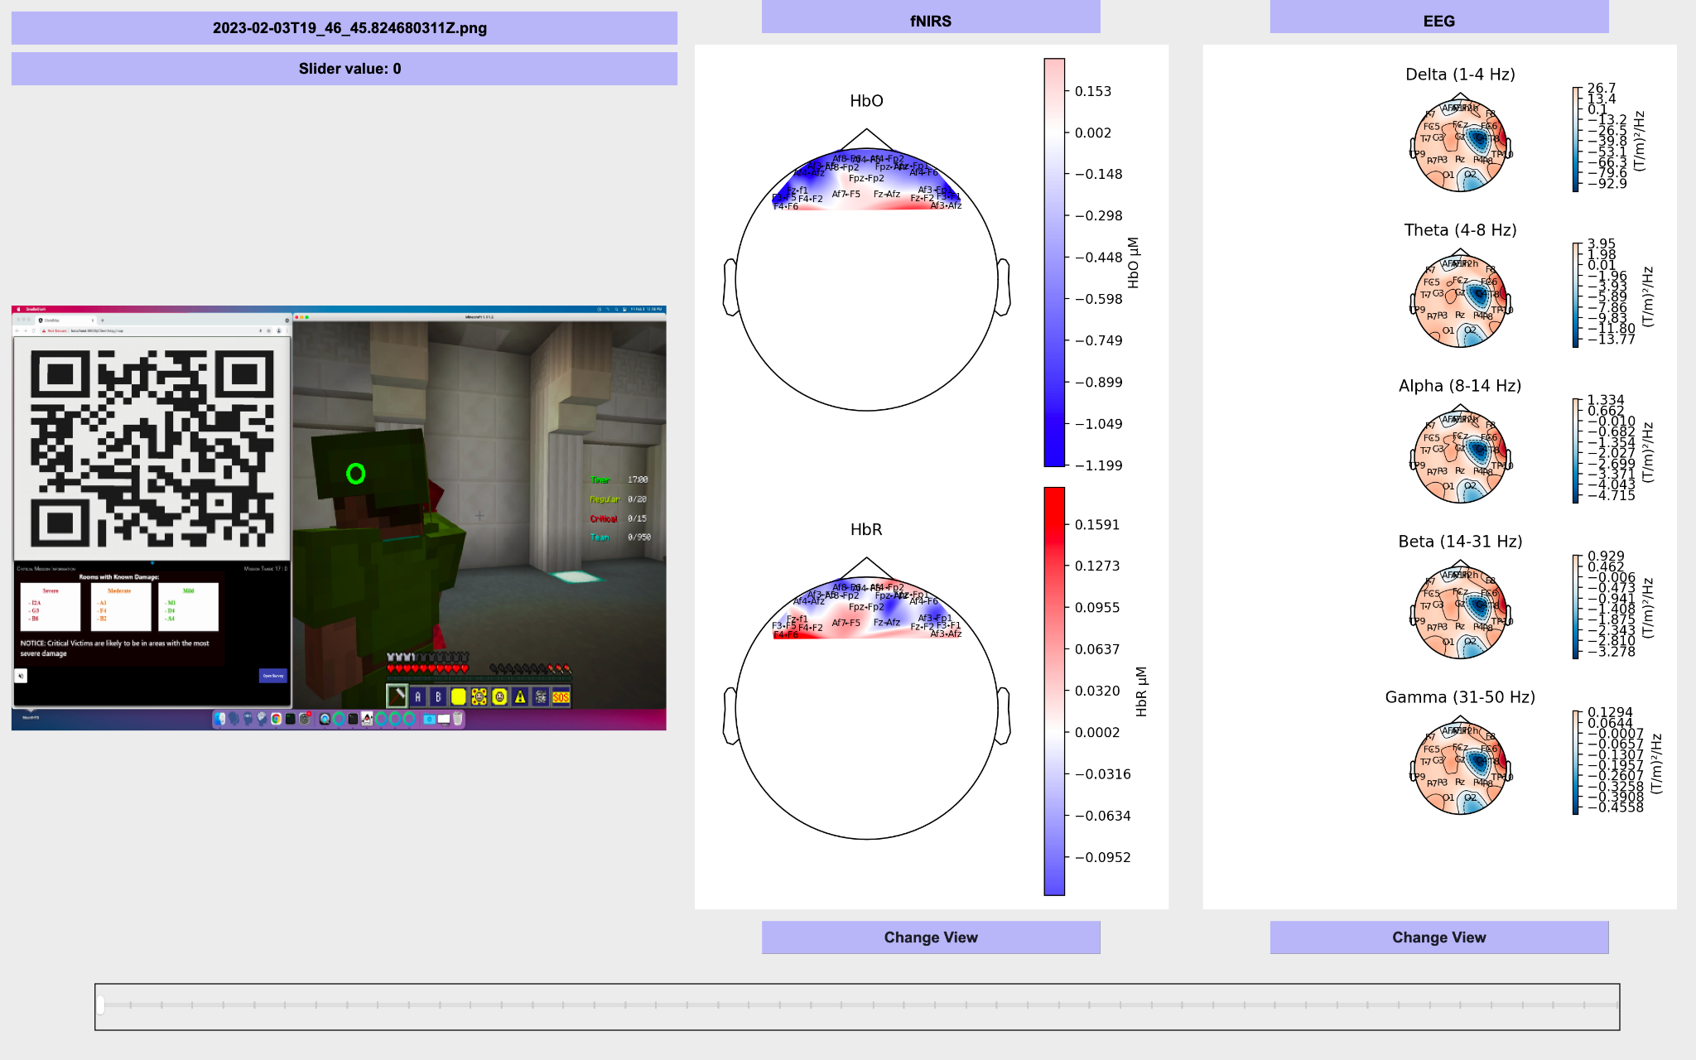
This is what we achieved.
ToMCAT Offline Viz | THE UNIVERSITY OF ARIZONA

Slide 12
Related works
05-01-2023

Slide 13
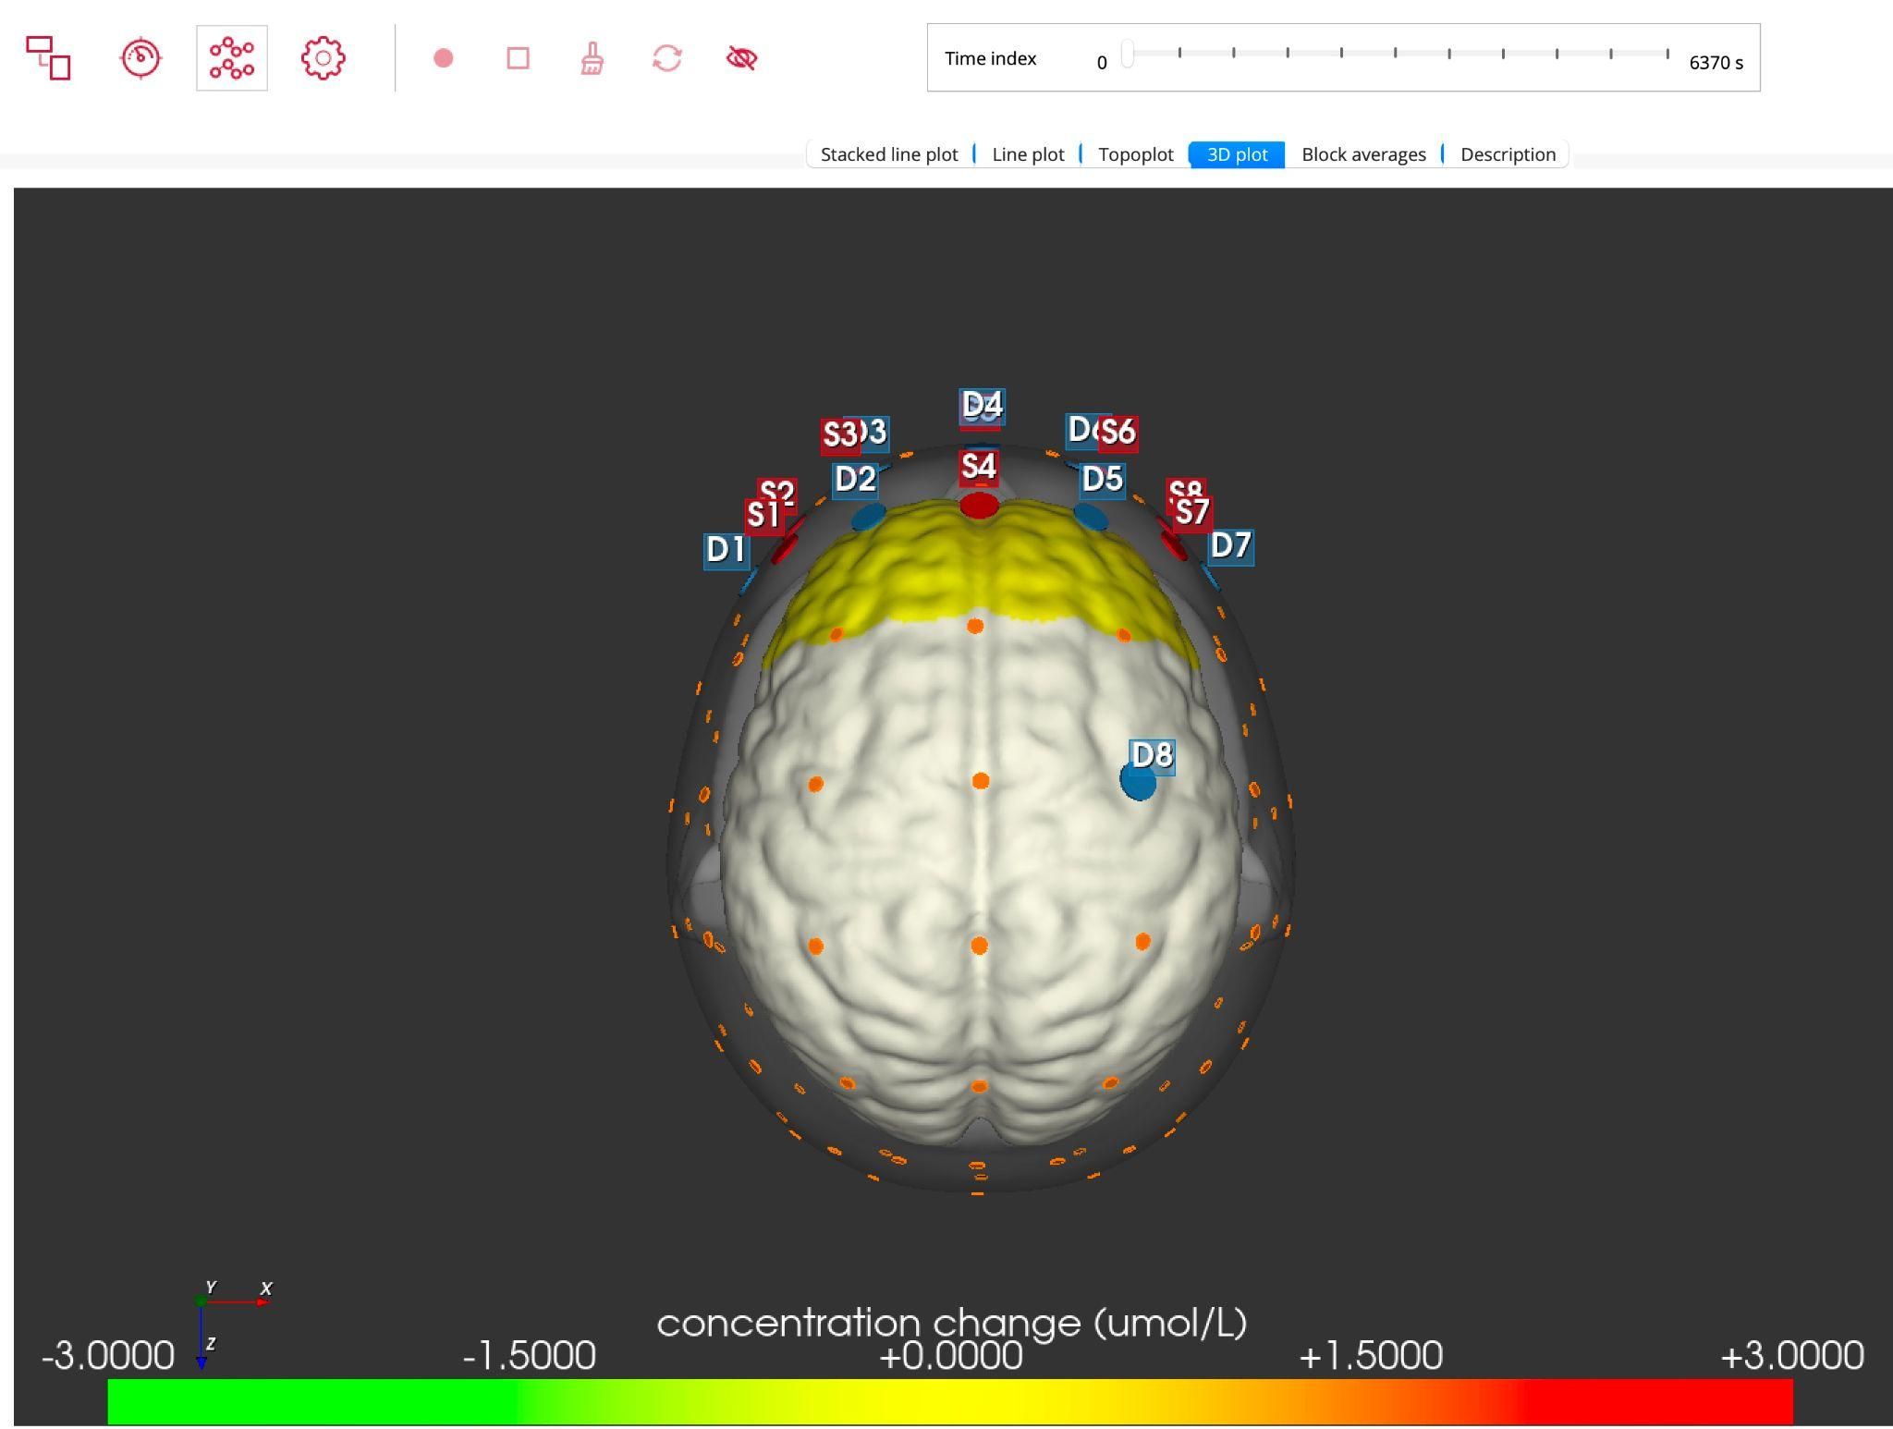
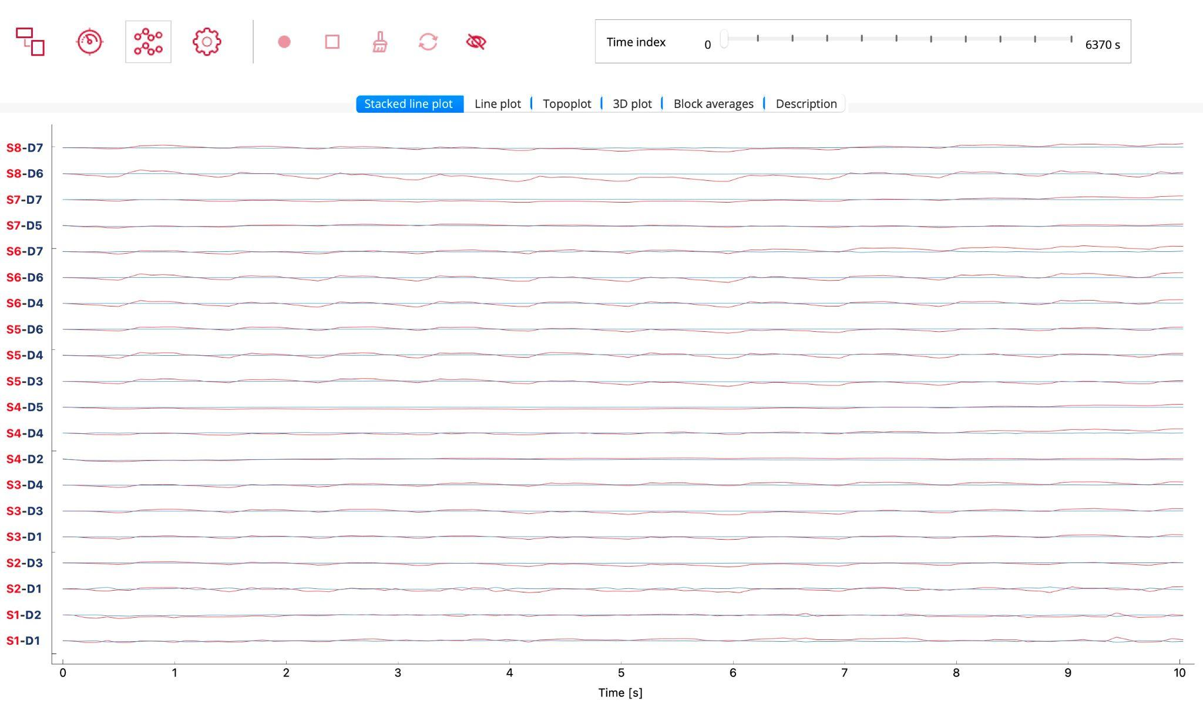
Aurora
Great tool to visualize collected fNIRS data.
Disadvantage: The timestamps are in frames rather than the precise time of experimentation that social scientists require for precise comparisons.
Due to the fact that the dataset is composed of both screenshots and fNIRS data acquired through timestamps, using this software to visualize the results becomes challenging.
ToMCAT Offline Viz | THE UNIVERSITY OF ARIZONA
https://nirx.net/software

Slide 14
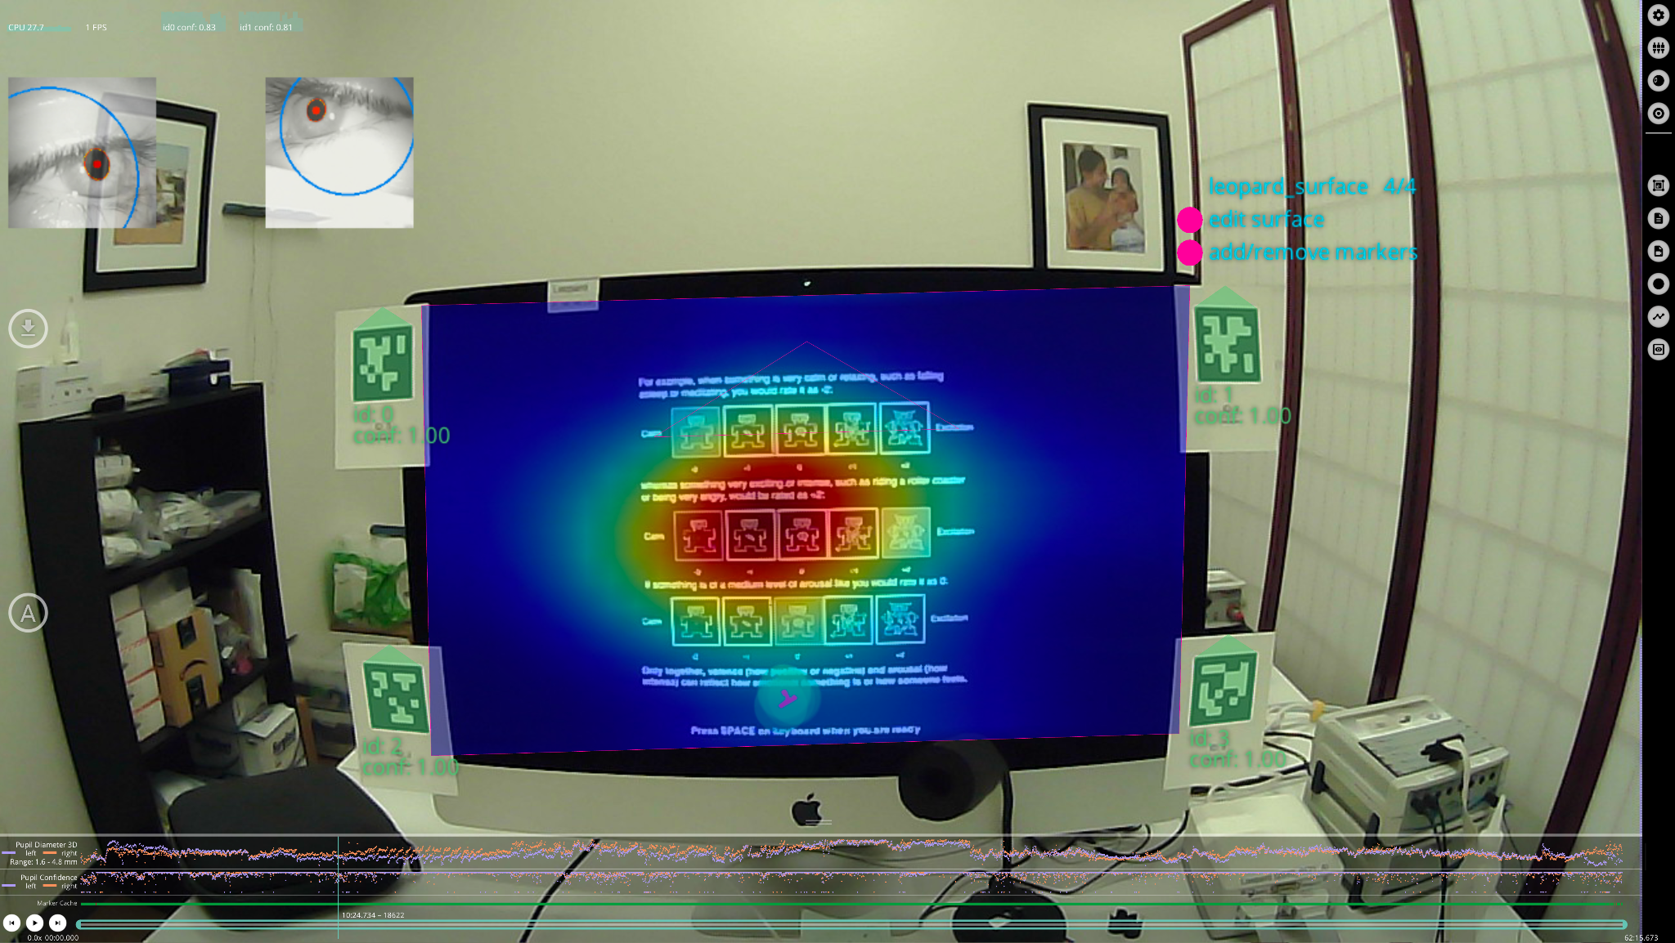
Pupil player
Great tool to visualize collected pupil dilation and fixation with the world view.
Disadvantage: The visualization contains irrelevant information that we are not concerned with, particularly regarding the world view.
Additionally, the tool cannot be utilized to map brain data visualization.
ToMCAT Offline Viz | THE UNIVERSITY OF ARIZONA
https://docs.pupil-labs.com/core/software/pupil-player/

Slide 15

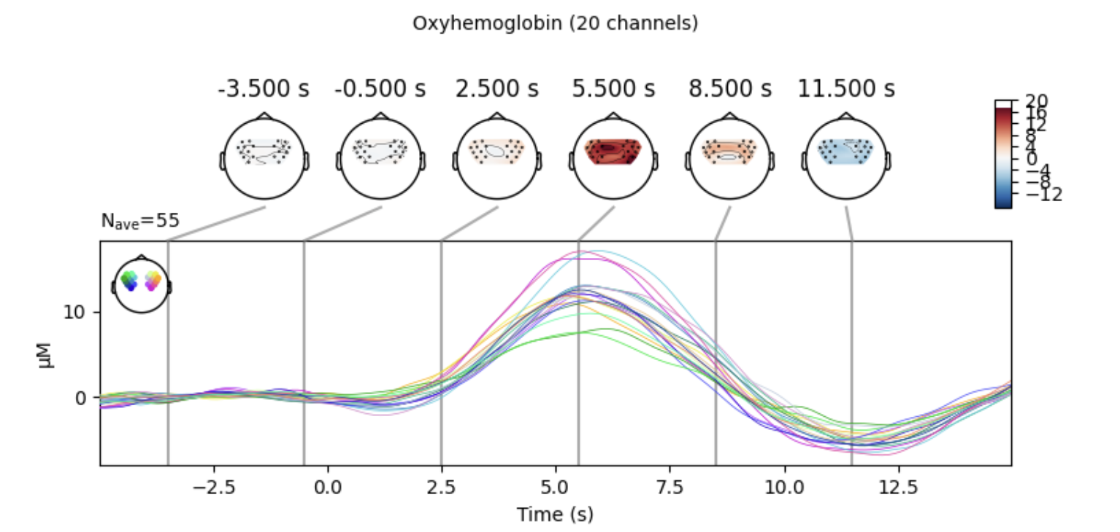
MNE Python
Great tool to visualize EEG data and minor support for fNIRS as well.
Disadvantage: The social scientists wants customization on visualizing all the data in the tool.
Nonetheless, we utilize this tool to plot fNIRS and EEG data onto a topographic brain map.
ToMCAT Offline Viz | THE UNIVERSITY OF ARIZONA
https://mne.tools/stable/auto_tutorials/preprocessing/70_fnirs_processing.html

Slide 16
Research Plan
05-01-2023

Slide 17
Data Description - from Lang lab
Approximately 116 GB for one experiment with three subjects
Type | Format | Metadata
Screenshots | PNG image | (Resolution: 1280X720, File size ∼ 600 kB) Sampled at 10 fps
fNIRS | CSV | (File size approx 53 MB) Sampled at 10.2 Hz
Eye Tracker | CSV | (File size approx 140 MB) Sampled at 200 Hz
EEG | CSV | (File size approx 1.2 GB) Sampled at 500 Hz
ToMCAT Offline Viz | THE UNIVERSITY OF ARIZONA

Slide 18
Techniques
Superimpose eye-tracking data onto screenshots to gain insights into the visual attention of team members. The process involves overlaying or combining the eye-tracking data onto the screenshots. By doing so, you can visualize and analyze where team members' visual attention is focused within the interface or content.
Navigation: The slider is a user interface component that allows you to compare and navigate through different time points or variations in each modality working in sync to facilitate the analysis of variations.
The user can use this interface to derive, explore and extract meaningful information or conclusions from the eye-tracking and fNIRS data or eye-tracking and EEG data. They can also identifying patterns, relationships, or trends with the eye when a player is playing.
ToMCAT Offline Viz | THE UNIVERSITY OF ARIZONA

Slide 19
Techniques
Juxtaposition of eye-tracking screenshots and Near-Infrared Spectroscopy (fNIRS) or Electroencephalography (EEG) data on the right-hand side of the screen, providing information on neural activity, for comparison or analysis.
The signal view for fNIRS displays the processed data as line plots, showing the HbO and HbR data over time. The signal view for EEG displays the processed data as line plots, showing the electrical activity as microvolts(mV) over time. Line plots provide a clear visualization of signal trends, fluctuations, and patterns, allowing researchers to analyze temporal dynamics of brain activity. We have used QtGraph to visualize signal view.
ToMCAT Offline Viz | THE UNIVERSITY OF ARIZONA
Notes:
Researchers can gain a more comprehensive understanding of brain activity. By analyzing two types of signals, namely fNIRS and EEG patterns with eye-tracking data, researchers can determine how visual stimuli affect the brain. This will allowing researchers to visualize and analyze neural activity in real-time or recorded sessions

Slide 20
Techniques
We are generating topological view which interpolates the values at each sensor location to create a smooth 2D map, allowing you to visualize the spatial distribution of the data across the sensor array. Color is used as a visual encoding technique to represent different brain activity levels or intensities in the topological view.
We have used MNE library to achieve topological view
There will be a switch between signal and topological views of the fNIRS and EEG data with a button based on their preference. When analyzing fNIRS data, researchers can focus on two aspects: trend and similarity
ToMCAT Offline Viz | THE UNIVERSITY OF ARIZONA

Slide 21
Why topological view, signal view and eye tracking by positioning pupil data on screenshots?
Topological View: Represents brain activity spatially, showing the distribution and patterns of neural activity across different regions of the brain using color-coding or heatmaps.
Signal View: Displays fNIRS and EEG data as line plots, allowing researchers to analyze variations, trends, and patterns in the signals over time.
Eye Tracking by superimposing Pupil Data on Screenshots: Records eye movements and gaze behavior, and overlays pupil data onto screenshots of visual stimuli to understand visual attention and fixation patterns of participants.
Correlates visual attention with neural activity: By combining eye tracking data with fNIRS and EEG data, researchers can analyze how visual stimuli attract visual attention and influence brain responses.
ToMCAT Offline Viz | THE UNIVERSITY OF ARIZONA

Slide 22
CITI and COI Training
Since Rupal and Harshita were not a part of the ToMCAT Project, they were required to do the below IRB (CITI) and COI training courses:
Native American
Social and behavioral BASIC
ToMCAT Offline Viz | THE UNIVERSITY OF ARIZONA

Slide 23
Results & Demo
05-01-2023

Slide 24
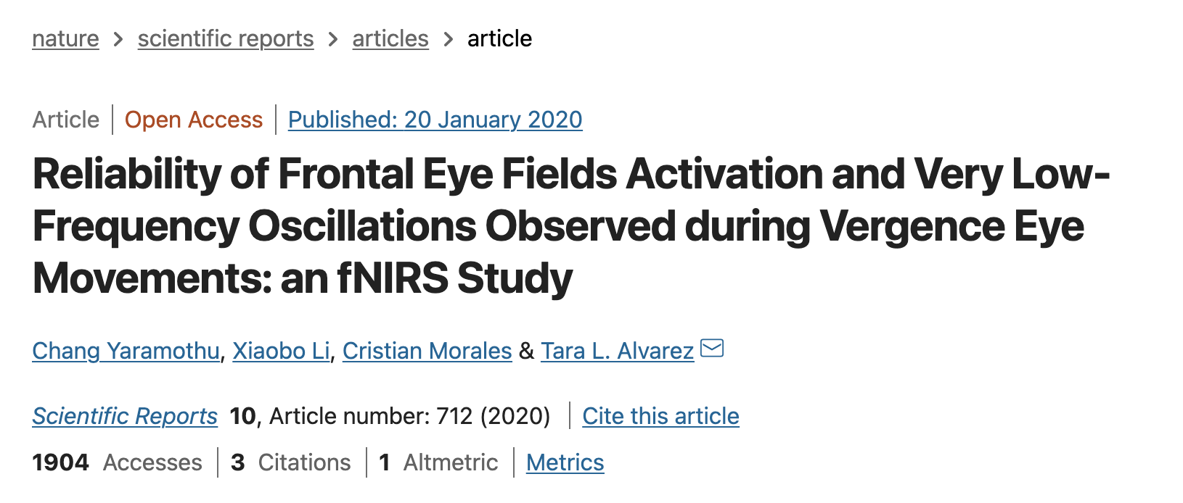
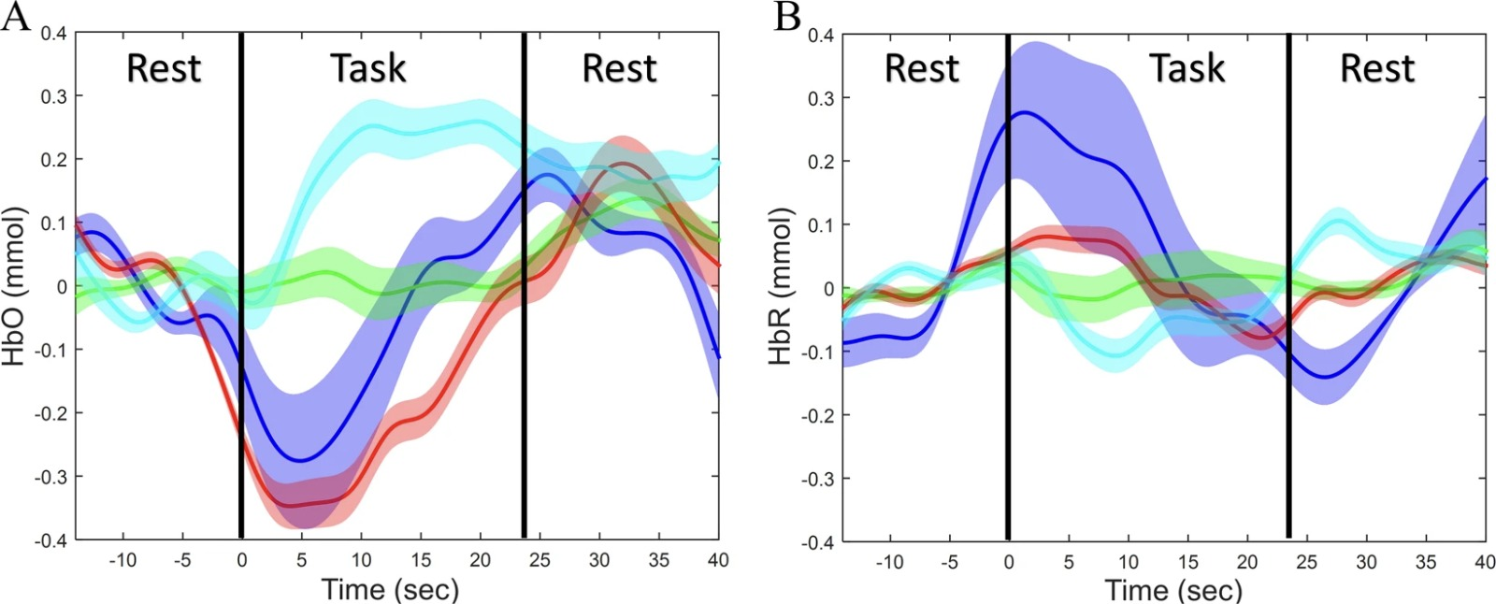
Rest State
Literature Review
ToMCAT Offline Viz | THE UNIVERSITY OF ARIZONA

Slide 25
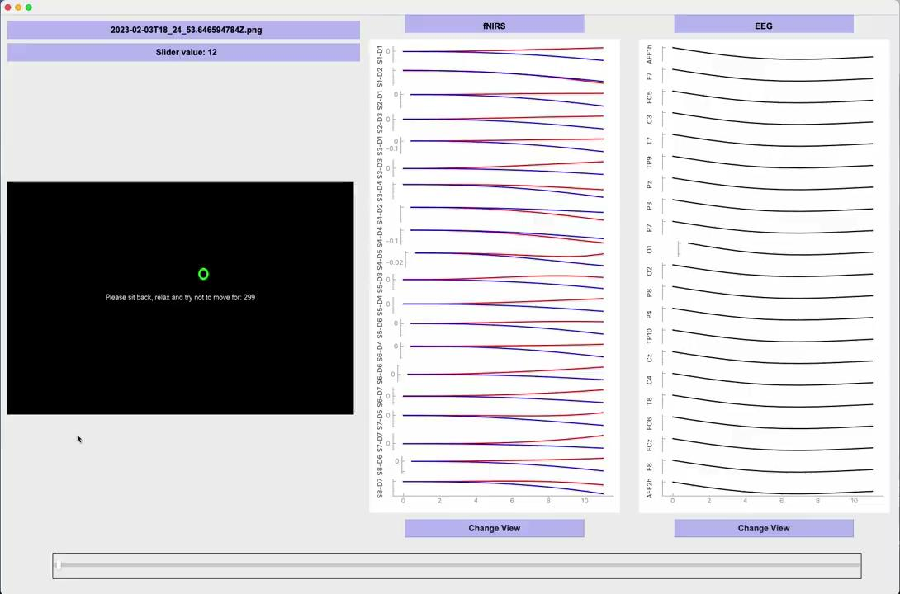
Rest State
ToMCAT Offline Viz | THE UNIVERSITY OF ARIZONA

Slide 26
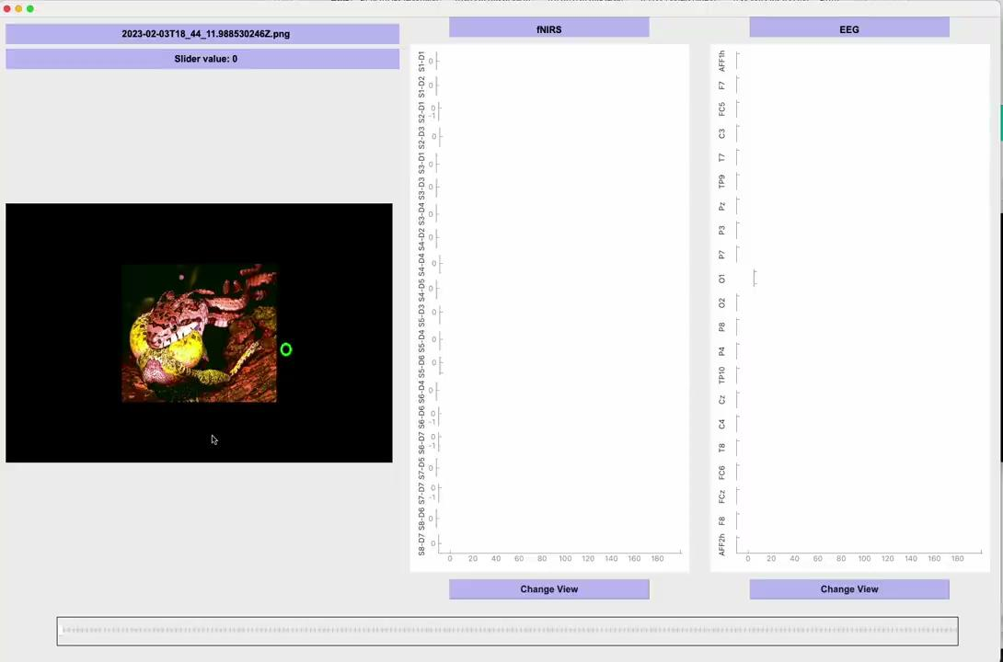
Affective State
ToMCAT Offline Viz | THE UNIVERSITY OF ARIZONA

Slide 27
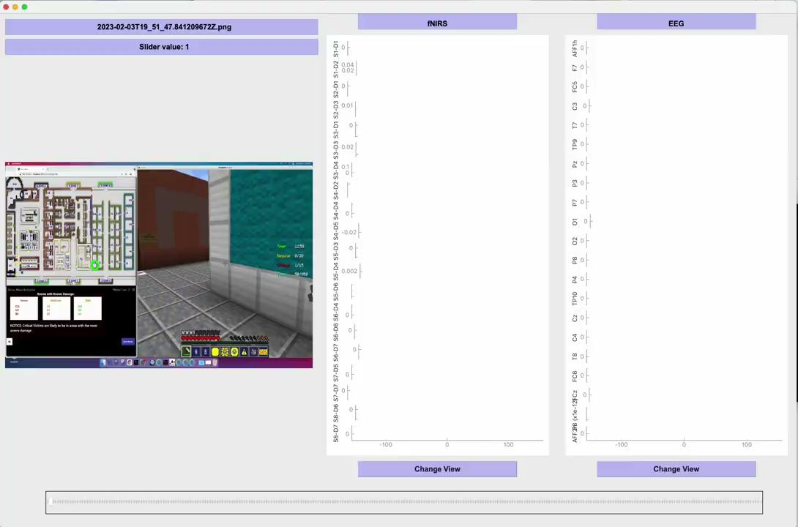
Minecraft
ToMCAT Offline Viz | THE UNIVERSITY OF ARIZONA

Slide 28
References
Frontiers in Neuroscience. (2013). The impact of physical exercise on converging measures of attentional control. Retrieved from https://www.frontiersin.org/articles/10.3389/fnins.2013.00267/full
Pupil Labs. Pupil Player. Retrieved September 15, 2021, from https://docs.pupil-labs.com/core/software/pupil-player/.
NIRx. NIRx Software. Retrieved May 1, 2023, from https://nirx.net/software
Kulkarni, A. M., Karyakarte, R. P., & Upadhyay, A. D. (2020). Determination of heavy metals in commercially available herbal formulations using Atomic Absorption Spectroscopy (AAS) and Inductively Coupled Plasma-Mass Spectroscopy (ICP-MS). Scientific Reports, 10(1), 1-12. doi: 10.1038/s41598-020-57597-4.
ToMCAT Offline Viz | THE UNIVERSITY OF ARIZONA

Slide 29

Thank you
ToMCAT Offline Viz | THE UNIVERSITY OF ARIZONA

Slide 30

Questions?

